Slide 1

Automation of Weather-Based Sales and Staffing Decisions
Joseph Boring
AI Automation | Project 5

Slide 2
Problem
A beachside coffee and ice cream kiosk in Miami needs a way to quickly adapt its daily product and staffing plans to the city's volatile weather. The current manual process of checking forecasts is inefficient, leading to reactive decision-making, potential over/understaffing, and missed sales opportunities when conditions change unexpectedly.

Slide 3
Solution
I designed and built an intelligent automation workflow through Zapier that acts as a daily operations assistant. Every morning at 7 AM, the system automatically fetches the Miami forecast via a Webhook, uses a Google Gemini AI model to interpret the data, and generates a custom operational plan. This plan, which includes product focus, staffing suggestions, and tailored marketing messages, is then emailed directly to the kiosk manager, enabling proactive, data-driven decisions.

Slide 4
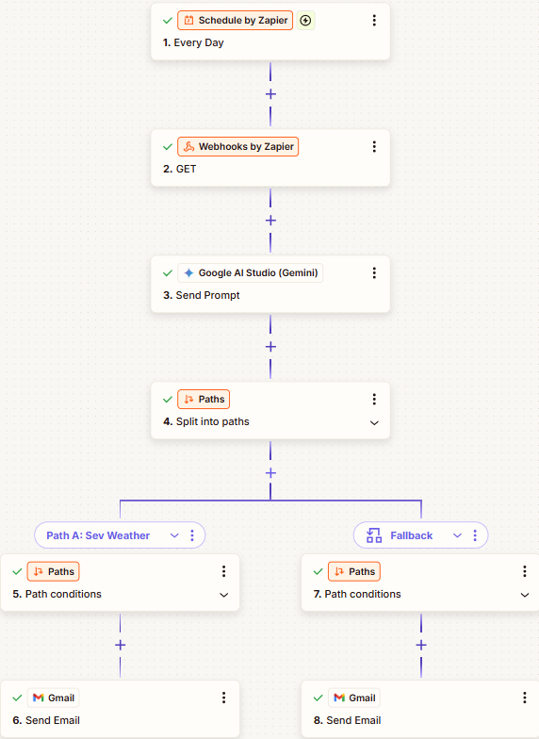
Workflow diagram

Slide 5
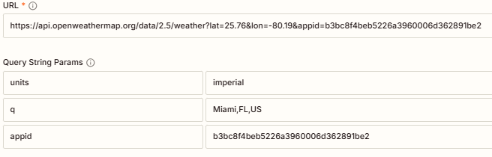
The Webhook
Censored api

Slide 6
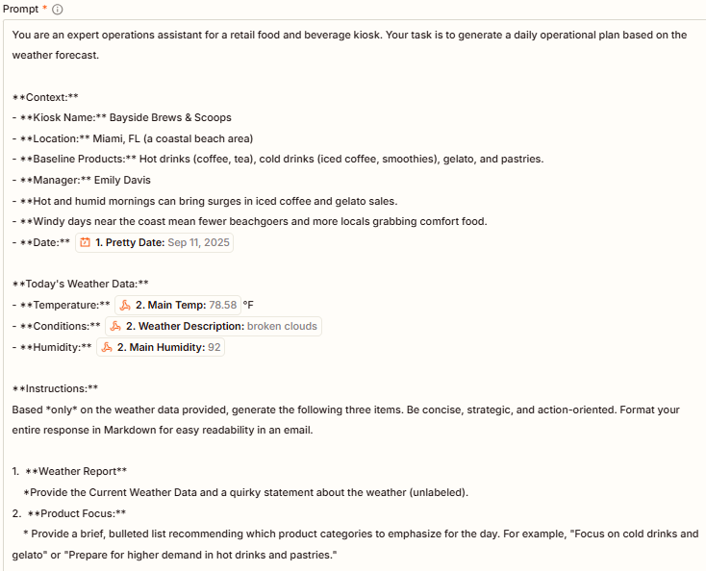
The Prompt 1/2

Slide 7
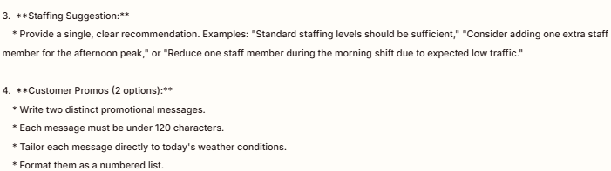
The Prompt 2/2

Slide 8
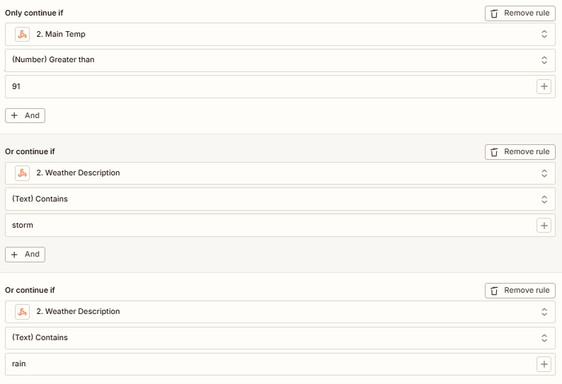
The Conditional Formating
1/2
Path A Severe Weather:

Slide 9
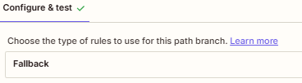
The Conditional Formating
2/2
Path B Default:

Slide 10
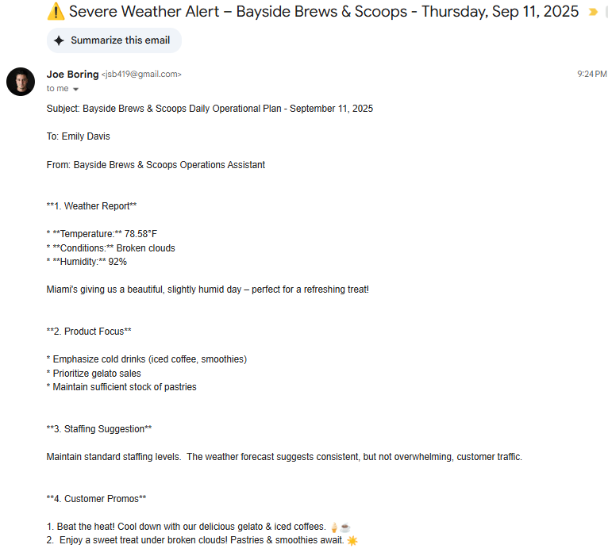
The Output Result 1/2
Path A Severe Weather:
**Email Label as “Important”

Slide 11
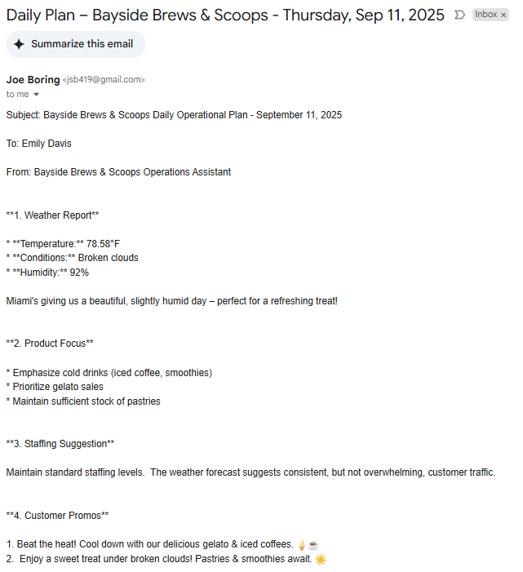
The Output Result 2/2
Path B Default:

Slide 12
Benefits
This automated system delivers tangible business value by transforming a manual task into a strategic asset.
Increased Efficiency: Saves the manager valuable time every morning by eliminating manual forecast checks and analysis.
Optimized Sales: Aligns product focus and promotions directly with weather conditions, maximizing revenue opportunities (e.g., promoting iced coffee on hot days).
Reduced Labor Costs: Provides data-driven staffing suggestions to prevent overstaffing on slow days and ensure adequate coverage during unexpected rushes.
Proactive Risk Management: The severe weather alert system gives the manager advance notice to take necessary precautions, protecting assets and ensuring safety.

Slide 13
Challenges & improvements
What worked well and what you’d improve if you had more time or tools
Challenge & Learning: A key challenge was ensuring the reliability of the API's data format. Initially, the temperature was returned in Kelvin, requiring a debugging process to correct the units parameter in the API call. This reinforced the importance of meticulous configuration and step-by-step testing.
What Worked: The structured prompt designed for the Gemini AI model was highly effective. By providing clear context, specific instructions, and a defined output format (Markdown), the AI consistently delivered accurate, well-organized, and immediately usable operational plans. This confirmed the value of precise instructions when working with LLMs.
Future Improvement: If given more time, I would enhance this workflow by integrating it with the kiosk's POS system. This would allow the AI to not only consider the weather but also analyze historical sales data relative to sales trends, leading to even more precise and profitable product and inventory recommendations.

